Slide 1
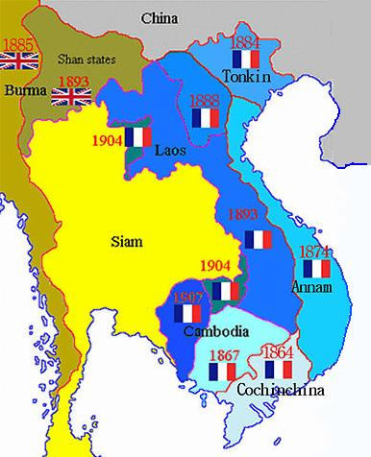
Before World War 2: France ruled Indochina
During the 19th century Vietnam was ruled by France and known as Indo-China.
The French began to change the Vietnamese way of life. For example, the rich people of Vietnam converted to Catholicism, and turned away from Buddhism. A French way of life was encouraged such as housing, fashion and language.
This created a new powerful Vietnamese elite class who helped the French keep control of the 30 million people living in Indochina. Those who resisted were punished or disappeared.

Slide 2
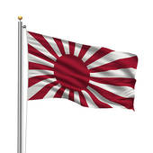
During World War 2: Japan ruled Vietnam
When France was defeated by Germany in 1940. Japan took over Vietnam from the French. They ravaged the country by taking all of the food and hundreds of thousands starved to death.
After Pearl Harbour and the US entry into the war. America provided training and weapons to Vietnam soldiers to fight the Japanese.
The Allies with the help of the Vietminh finally defeated the Japanese in 1945.
The Vietminh as they became known declared Vietnam independent and set up a new government in the North of Vietnam.

Slide 3
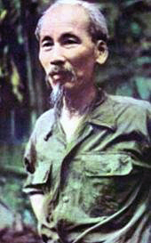
After World War 2: France tries to take back Vietnam
Ho Chi Minh who led the Vietminh was a communist and wanted independence for Vietnam.
After WW2 the US were afraid of Communism spreading so supported the French in their attempts to stop Vietnam becoming communist.
The French were finally defeated in 1954 at the battle of Dien Bien Phu. At the peace conference it was agreed that the country would be divided into two and there would be elections to decide whether Vietnam was going to be democratic or communist.

Slide 4
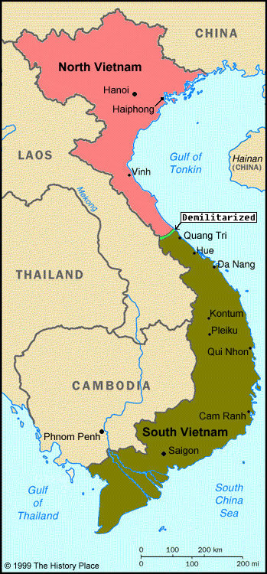
Vietnam before WW2
Vietnam during WW2
The US switched from supporting Ho Chi Minh to supporting the French. Explain why you think the US did this?
Vietnam after WW2

Slide 5
Quiz
What beginning with ‘I’ was the whole of the Vietnam and Cambodian region called?
What language was taught in Schools before WW2?
Who ruled Vietnam during WW2?
Who was the leader of the Vietminh?
What beginning with ‘C’ was he?
What beginning with ‘I’ did he want for Vietnam?
What battle did France lose?
What year was this battle?
What 2 things were agreed at the peace conference in Paris?

Slide 6
Answers
French Indochina
French
Japan
Ho Chi Minh
Communist
Independence for Vietnam from foreign rule.
The Battle of Dien Bien Phu
1954
Vietnam was divided between North and South. Elections would decide whether Vietnam would become communist or capitalist

Slide 7
Why did America get involved in Vietnam?
Key
Terms

Slide 8
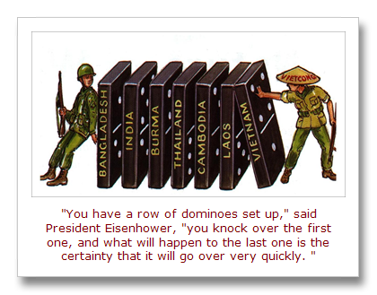
Why was the US government using the ‘domino theory’ as part of their Policy of Containment?

Slide 9
Create a balance sheet of the positive and negative aspects of the Diem government. The first one has been done for you.
Positive | Negative
Diem was anti – Communist. | He was corrupt.

Slide 11
Learning review
Which of the following options was the main reason America got involved in the Vietnam conflict?
Option 1: The defeat of the French & Geneva conference
Option 2: The domino theory
Option 3: The weakness of the Diem government

Slide 12
How did the war escalate?
To do this we will:-
Answer 4 comprehension questions.
Create a mind map.
Use representations to assess which U.S. President wanted war the most.

Slide 14
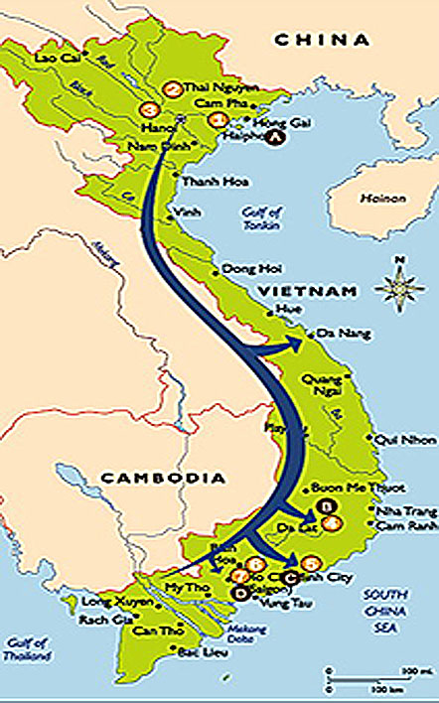
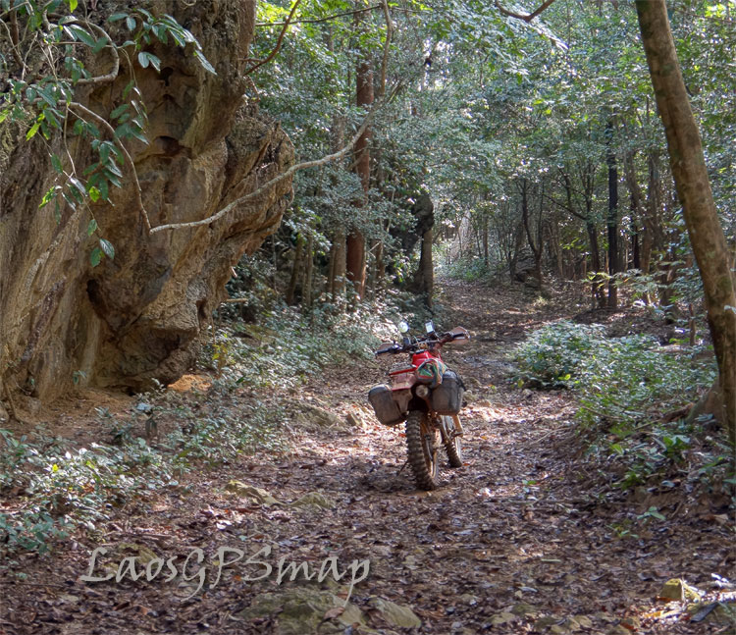
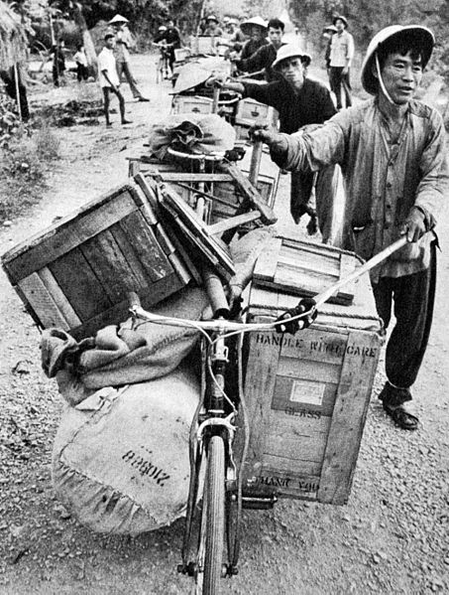
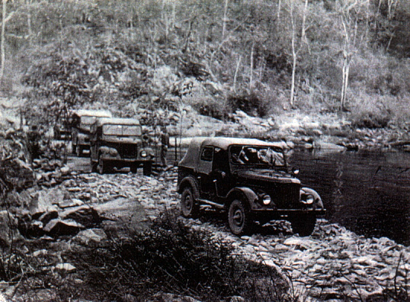
Ho Chi Minh trail
This supply route from the North to the South was maintained by 100,000 peasants moving supplies through the jungle.

Slide 15
Full sentence answers
Task 1
Why did the National Liberation Front become known as the Viet Cong?
Why did Diem request more support from the US to fight the Viet Cong?
What was aim of the Viet Cong and where did their support mainly come from?
What was the Ho Chi Minh trail?

Slide 17
President John F Kennedy (JFK) gave….
Task 2
Strategic hamlets were….
What types of support did the US give to Diem’s Government?
President Lyndon Baines Johnson gave….
JFK also gave $40k to….

Slide 18
Task 3
Which President of America was most interested in escalating the war?

