Slide 1
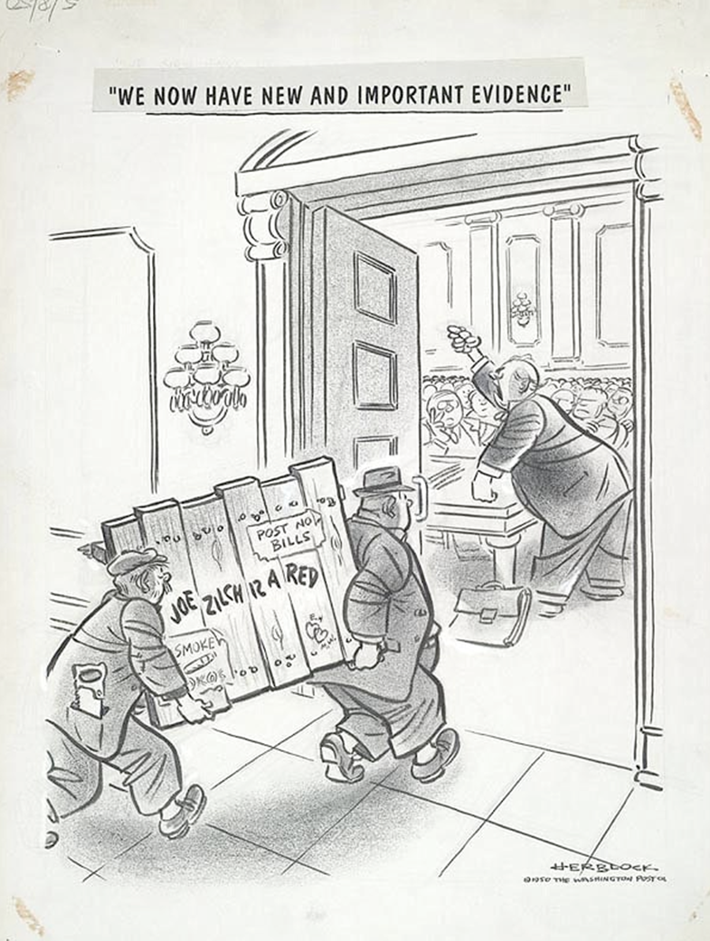
How to write section 1
All materials taken from Teacher Support Material and Specification (IBO website) and workshop materials provided by Ed Bond (IBDP History Workshop, Brussels November 2015)
"We now have new and important evidence” by Herb Block (Herblock), 1950. What evidence will be used to support your investigation?
https://www.loc.gov/exhibits/herblocks-history/fire.html

Slide 2
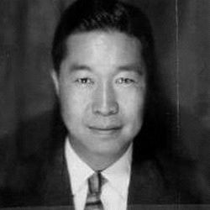
The IA
The IA is a historical investigation into a historical topic chosen by the student.
The idea is to actually experience the authentic work of the historian – developing an enquiry and exploring source material.
Historians Shelia Fitzpatrick, Immanuel Hsu, Brittney Cooper, Michael Lynch

Slide 3
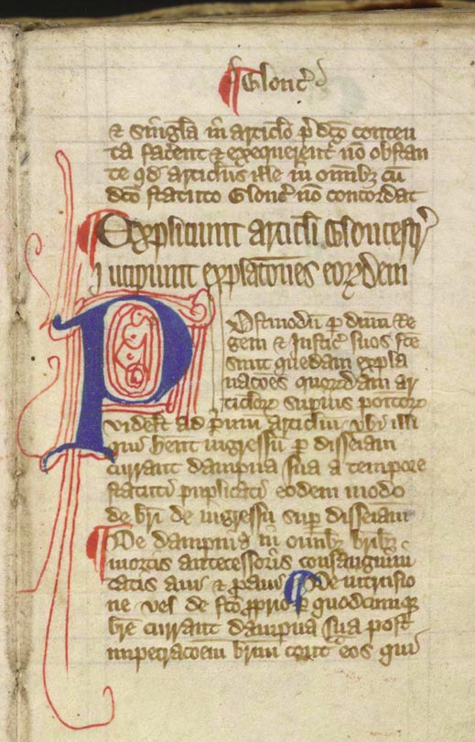
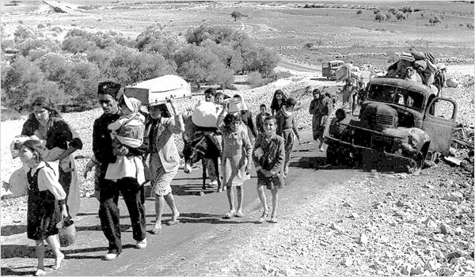
What is the purpose of section 1?
To analyse in detail two of the sources that will be used in the investigation.
Clearly state the question
Briefly explain the two sources selected, including why they are relevant to the investigation (they must be used in Section 2)
Analyse in detail the two selected sources: OPCVL
Select the sources: academic books, primary sources, graphics.

Slide 4
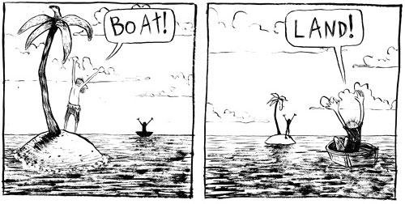
What do the moderators say?
Select samples that show different viewpoints/a variety of perspectives
Select samples that have different audiences/purposes. i.e: don’t select two school textbooks
Clearly explain the relevance of the sources to the investigation
Ensure that the values and limitations are well connected to the origin, purpose and content
Seek out sources that provide alternative points of view about the issue.

Slide 5
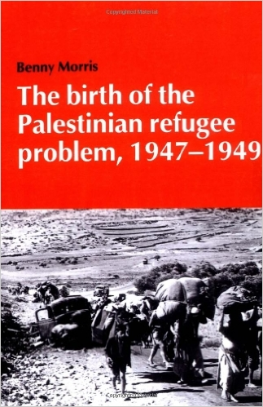
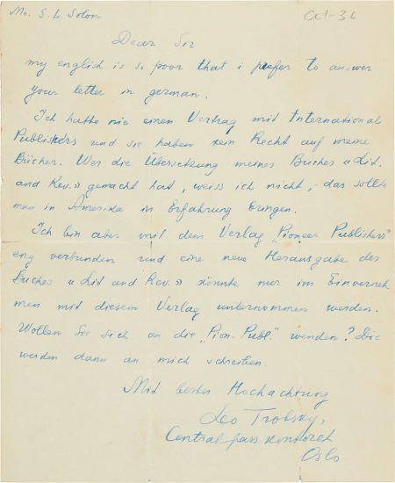
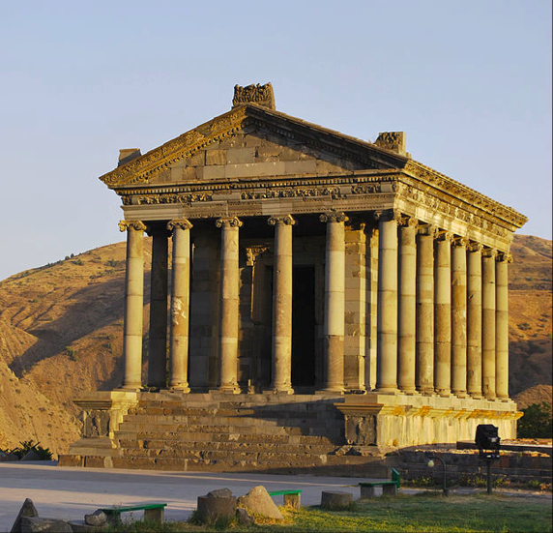
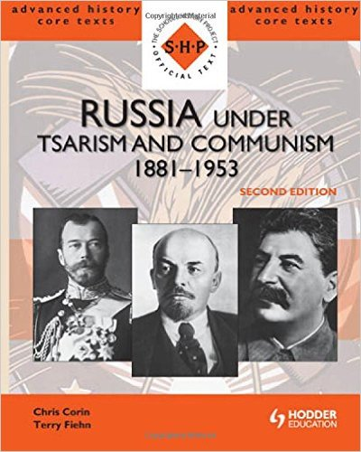
Primary or Secondary?
Primary sources can provide rich analytical opportunities, and secondary sources can be more useful – so one of each may be a good starting point. You may use images, charts, graphic sources, but these come with their own challenges.

Slide 6
Sample 3: How successful was Mao’s attempt to reassert his authority over the party through the Cultural Revolution?

Slide 7
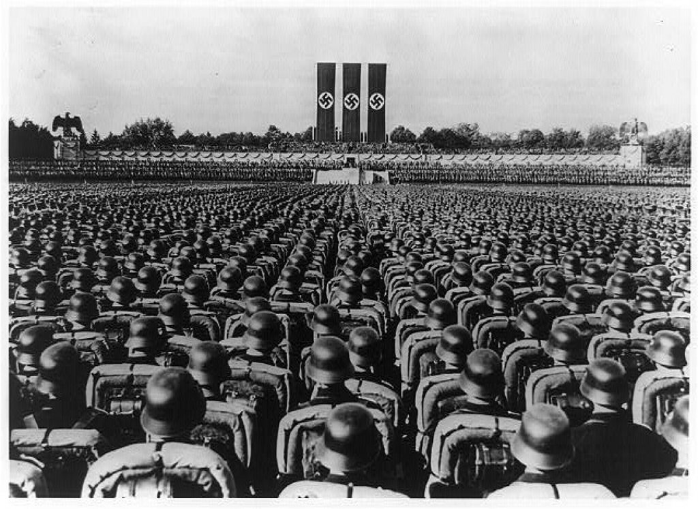
Sample 1: To what extent did Hitler create a totalitarian system of government?

